Slide 1

Understanding the Mysteries of the Brain
Prof Keith Murphy
Professor of Neuropharmacology
Neurotherapeutics Research Group
UCD School of Biomolecular and Biomedical Science,
Conway Institute, University College Dublin
UCD SFI Girls in STEM Initiative,
December 2019

Slide 2

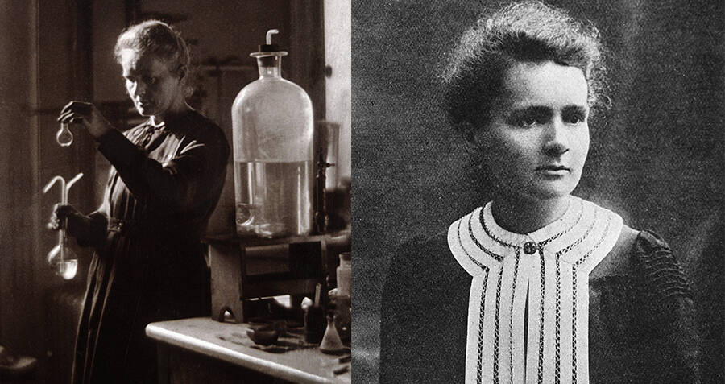
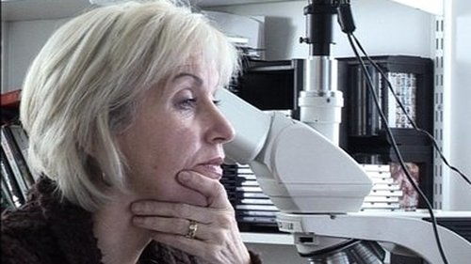
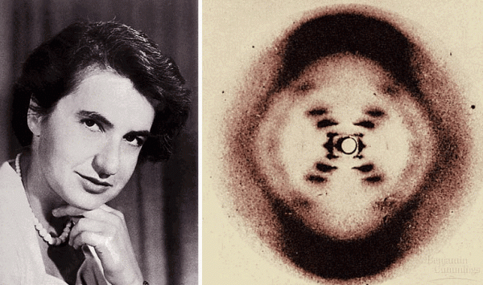
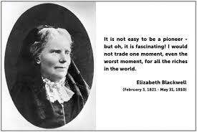
Women in the Biomedical Sciences
‘Nothing in life is to be feared, it is only to be understood. Now is the time to understand more, so that we may fear less..’
Marie Curie Sklodowska
Marie Cassidy
Elizabeth Blackwell
‘It is not easy to be a pioneer – but oh, it is fascinating! I would not trade one moment, even the worst moment, for all the riches in the world.’
Rosalind Franklin

Slide 3
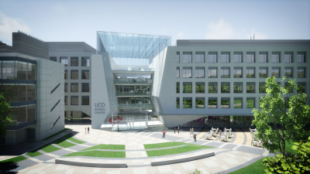
UCD O’Brien Centre for Science

Slide 4

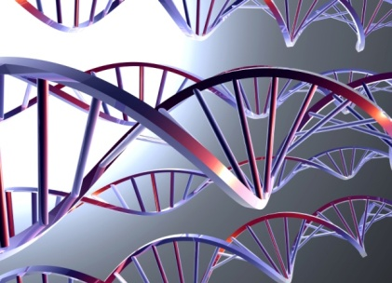
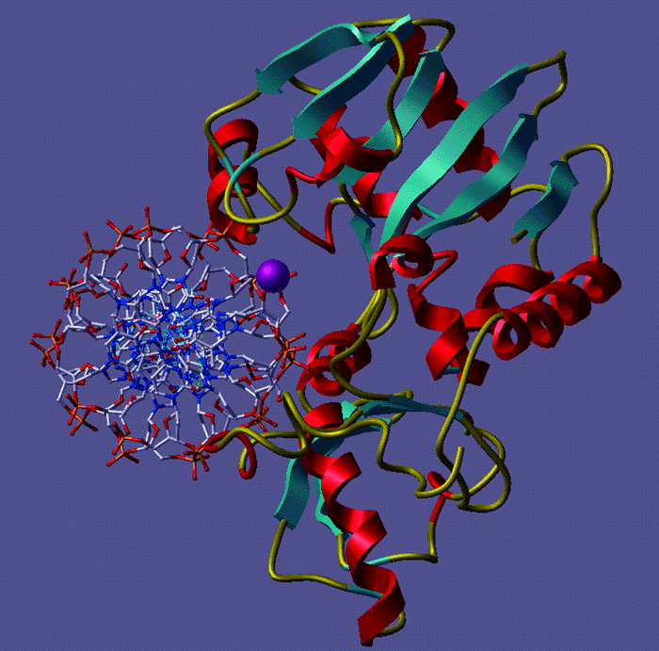
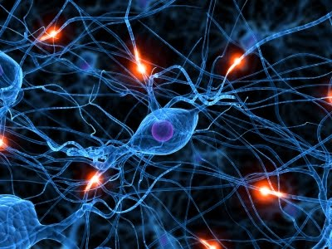
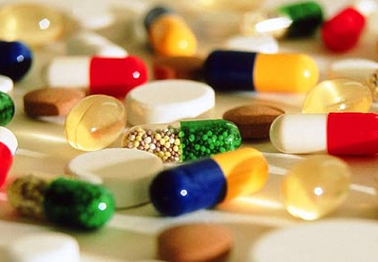
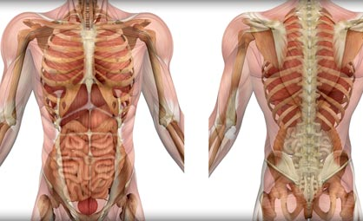
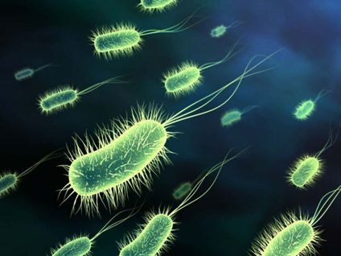
UCD Biomedical Sciences
What we are
What we do
Genetics
Biochemistry
Understand normal biological functions
Neuroscience
Pharmacology
Understand Diseases
Find new treatments
Physiology
Microbiology
Biotechnology

Slide 5
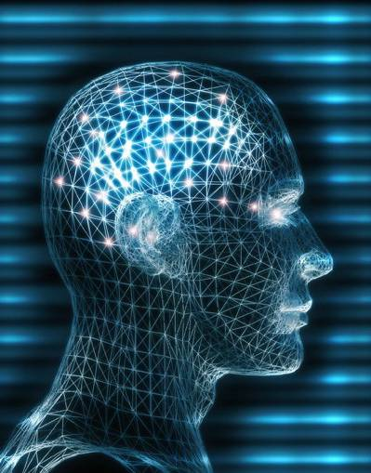
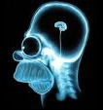
Brain function and dysfunction

Slide 6
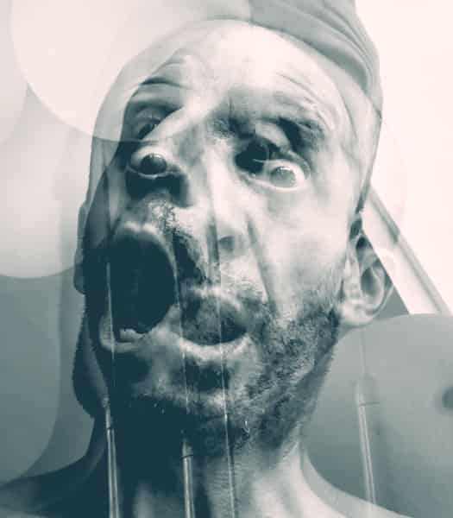
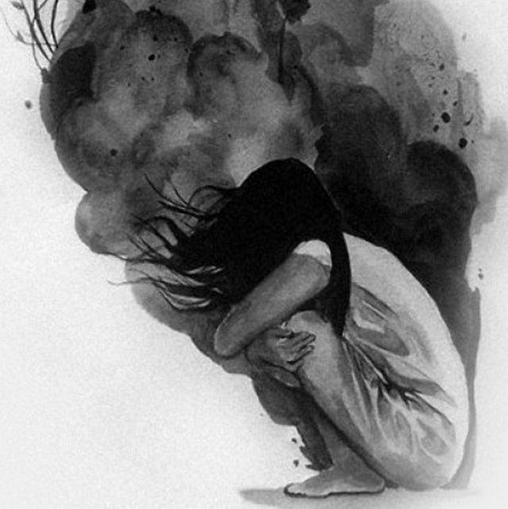
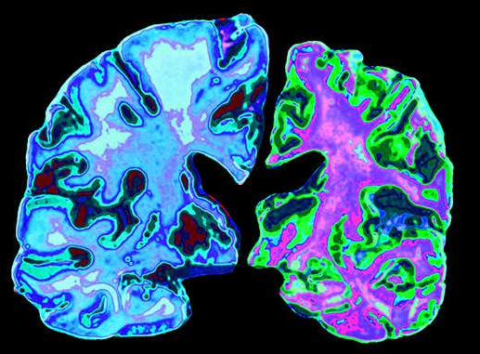
Brain function and dysfunction
Schizophrenia
Drug Addiction
Anxiety
Depression
Alzheimer’s
Parkinson’s disease
Multiple Sclerosis

Slide 7
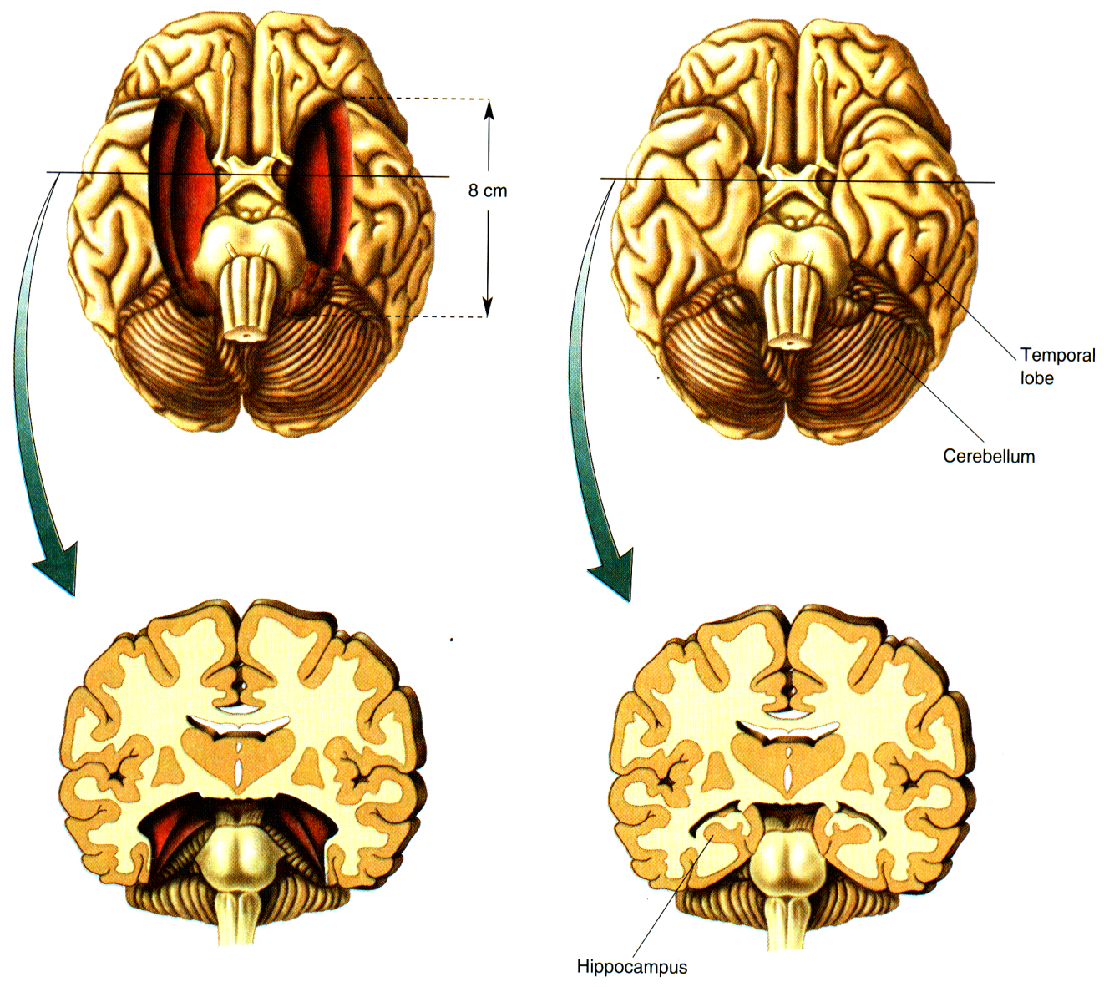

The hippocampus is required for memory formation
Patient H.M.
Surgery at 27
Died at 82

Slide 8
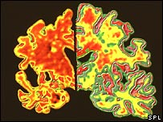
Alzheimer’s disease
Alzheimer’s
brain
Normal
brain

Slide 9
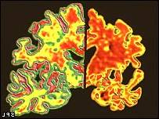
Alzheimer’s treatment
Current drugs only treat symptoms
but......
New
approaches!!!

Slide 10
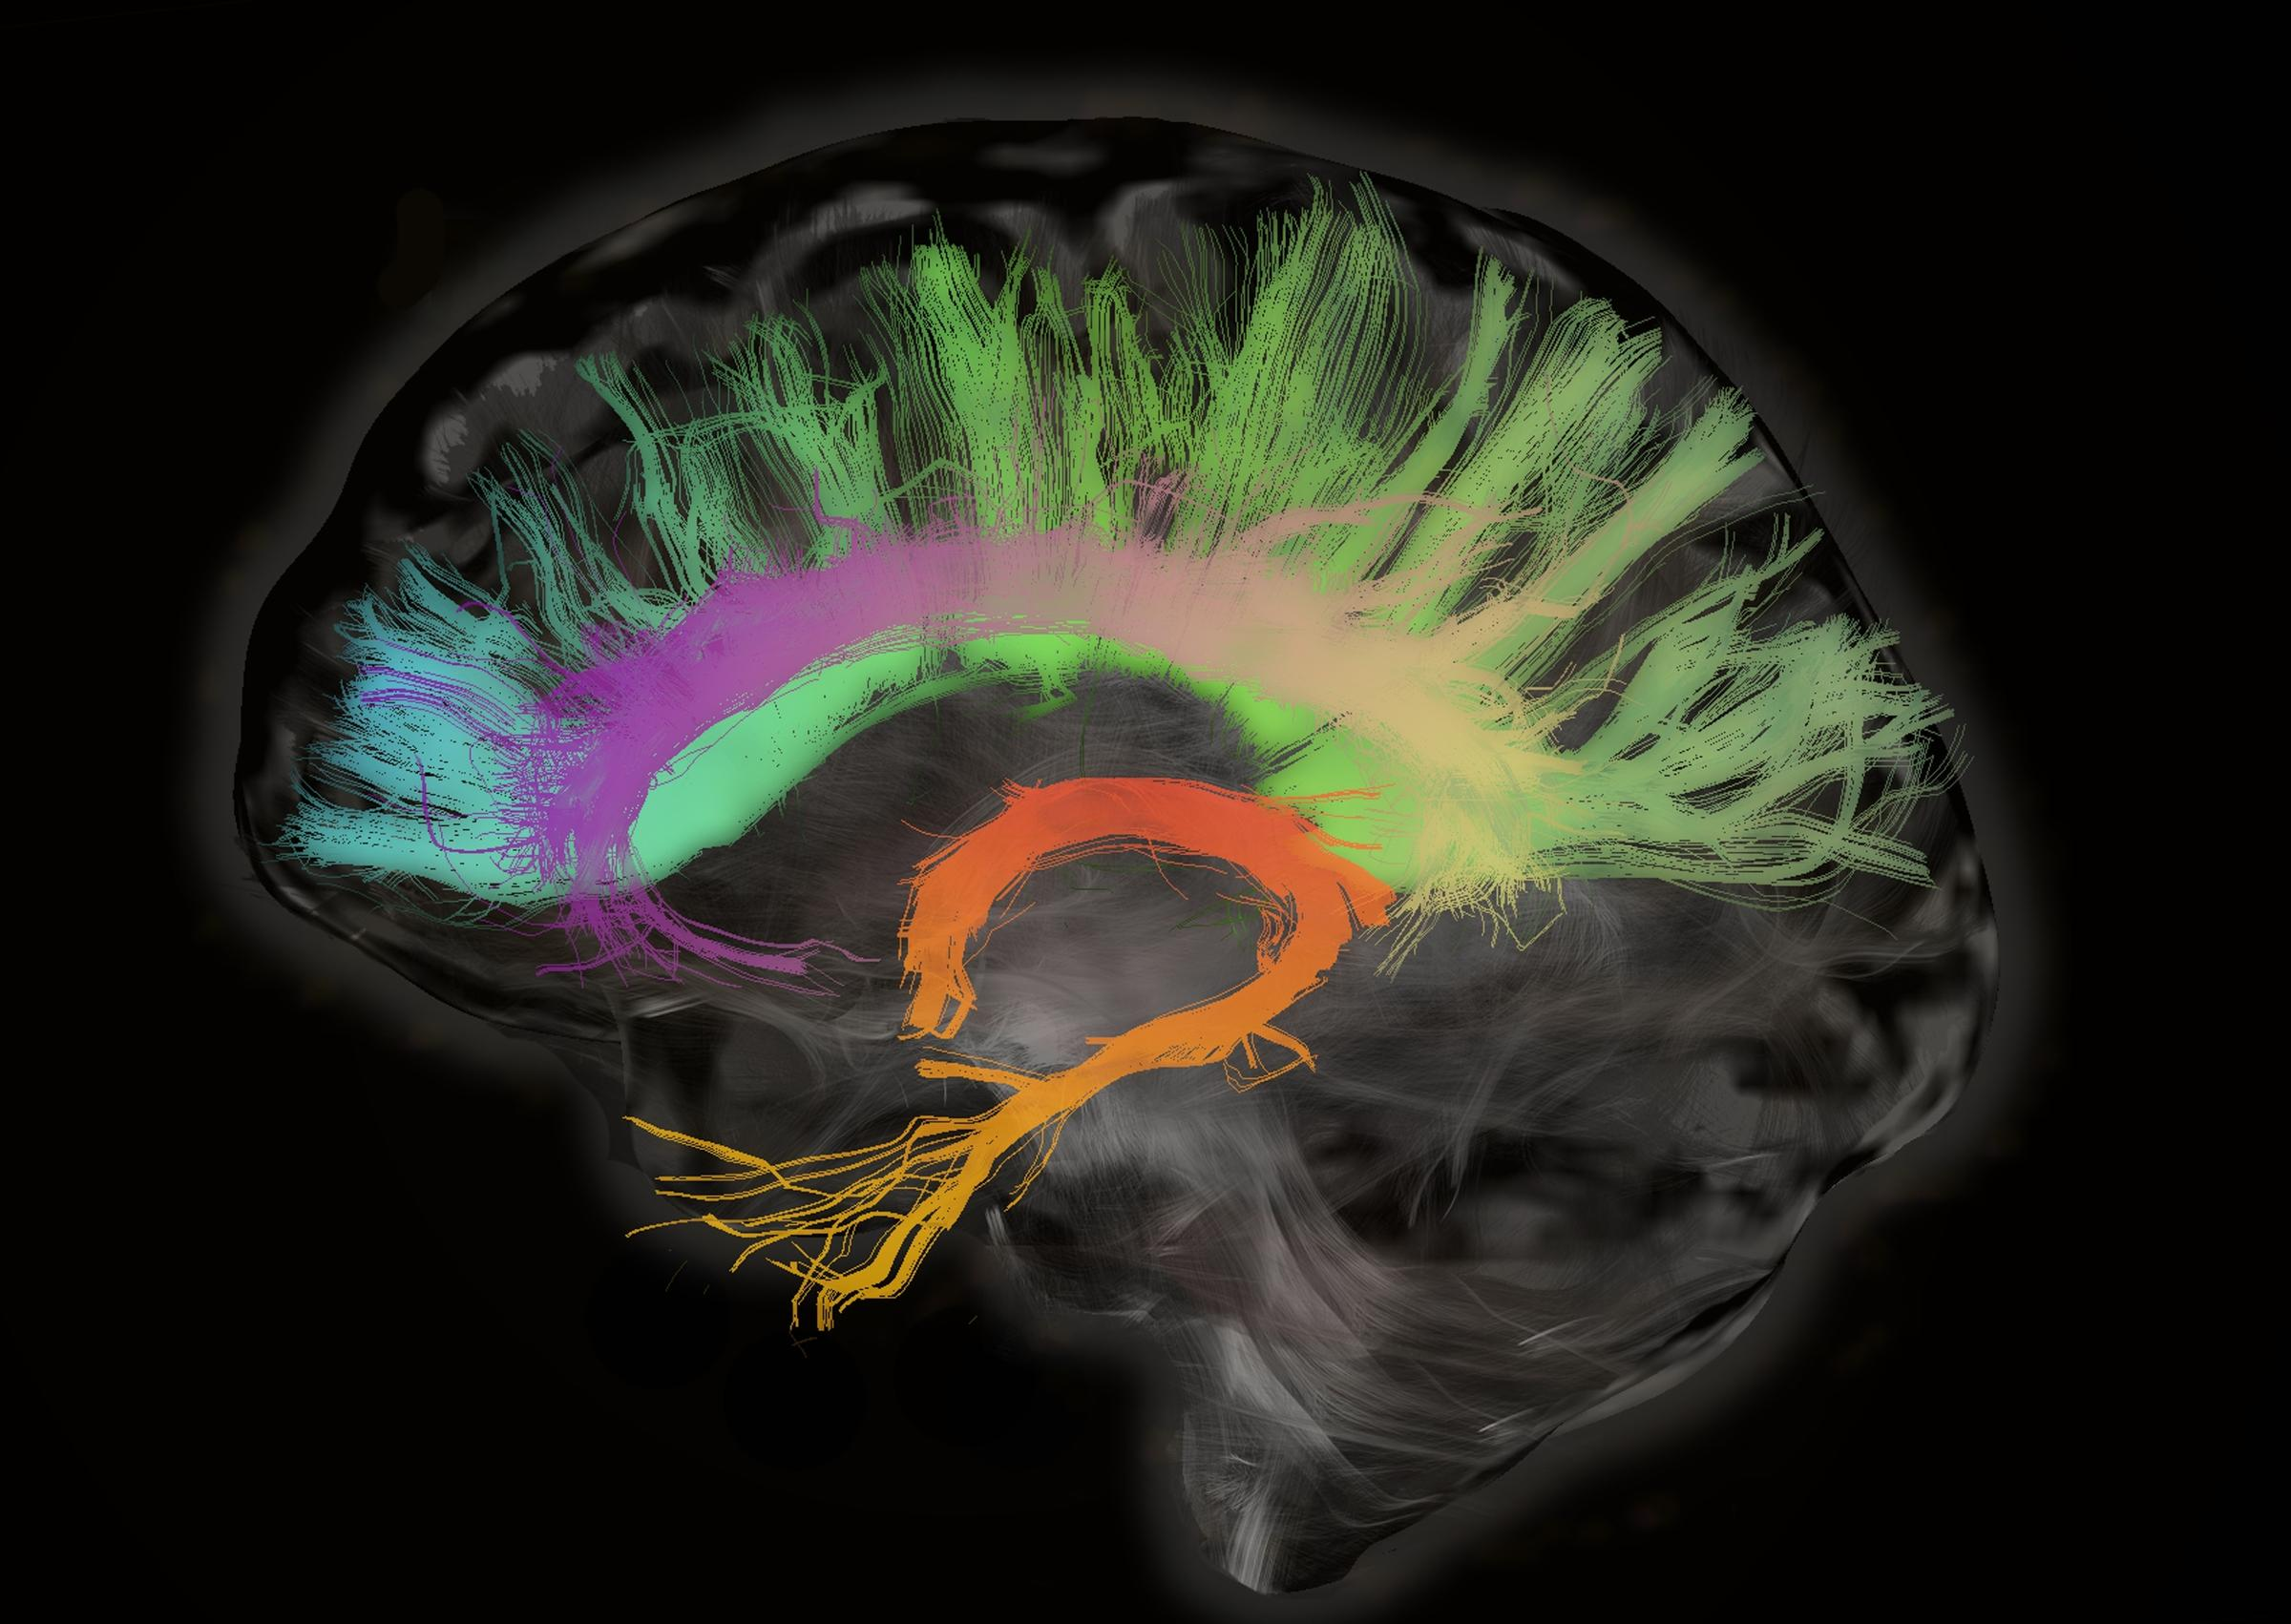
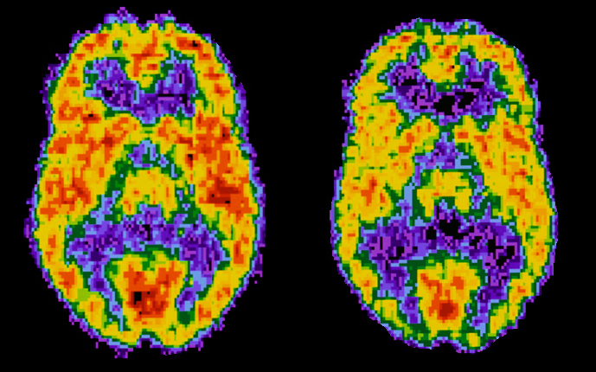
Looking into the brain
TDI: Pathways & Connections
fMRI: Brain Activity
‘Normal’
Cocaine addict

Slide 11
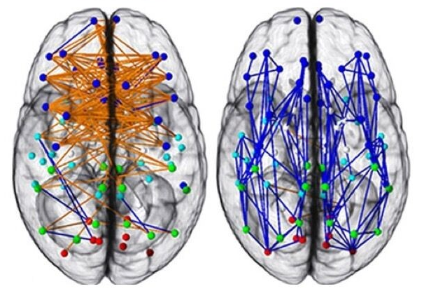
Female and Male brains have different connection patterns
Typical female brain
Most connections
go from side to side across the two
hemispheres
of the brain.
We believe this
could account for
better verbal skills
and intuitive
abilities in women.
Better multitasking ability.
Typical male brain
Most connections run between the front and back parts of
the same brain hemisphere,
which could
account for the
better spatial
skills and muscle control in men.
Better focus on individual task.
Source: Ragini Verma, UPenn

Slide 12
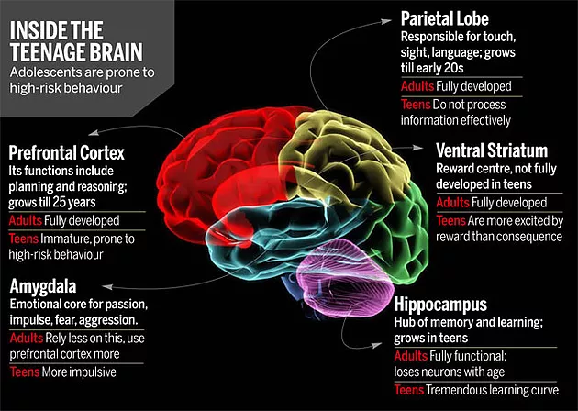
The teenager brain is different

Slide 13
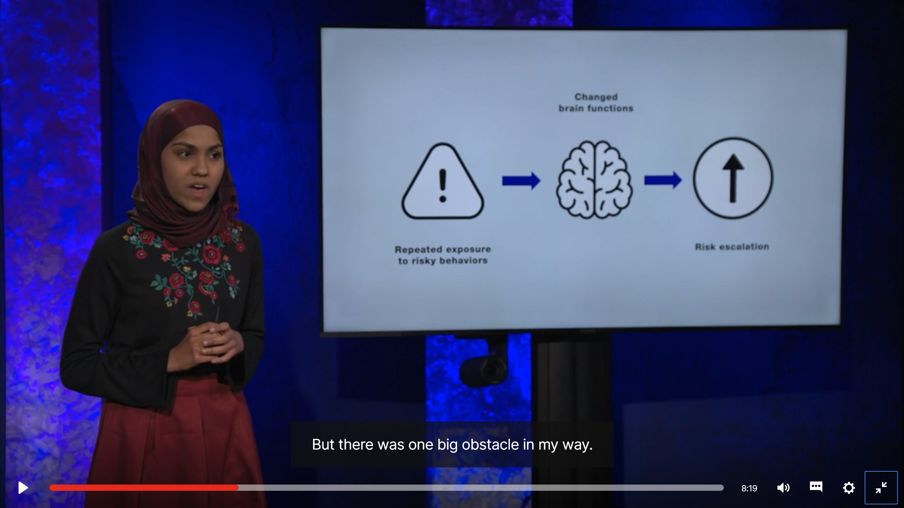
TED Talk by Kashfia Rahman:
How risk-taking changes a teenager’s brain
https://www.ted.com/talks/kashfia_rahman_how_risk_taking_changes_a_teenager_s_brain#t-10441

Slide 14
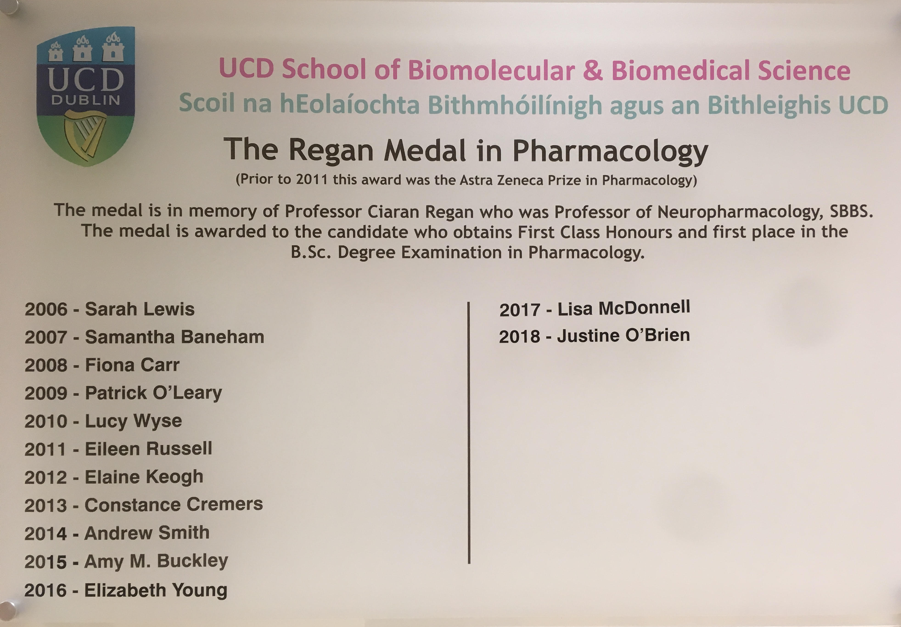
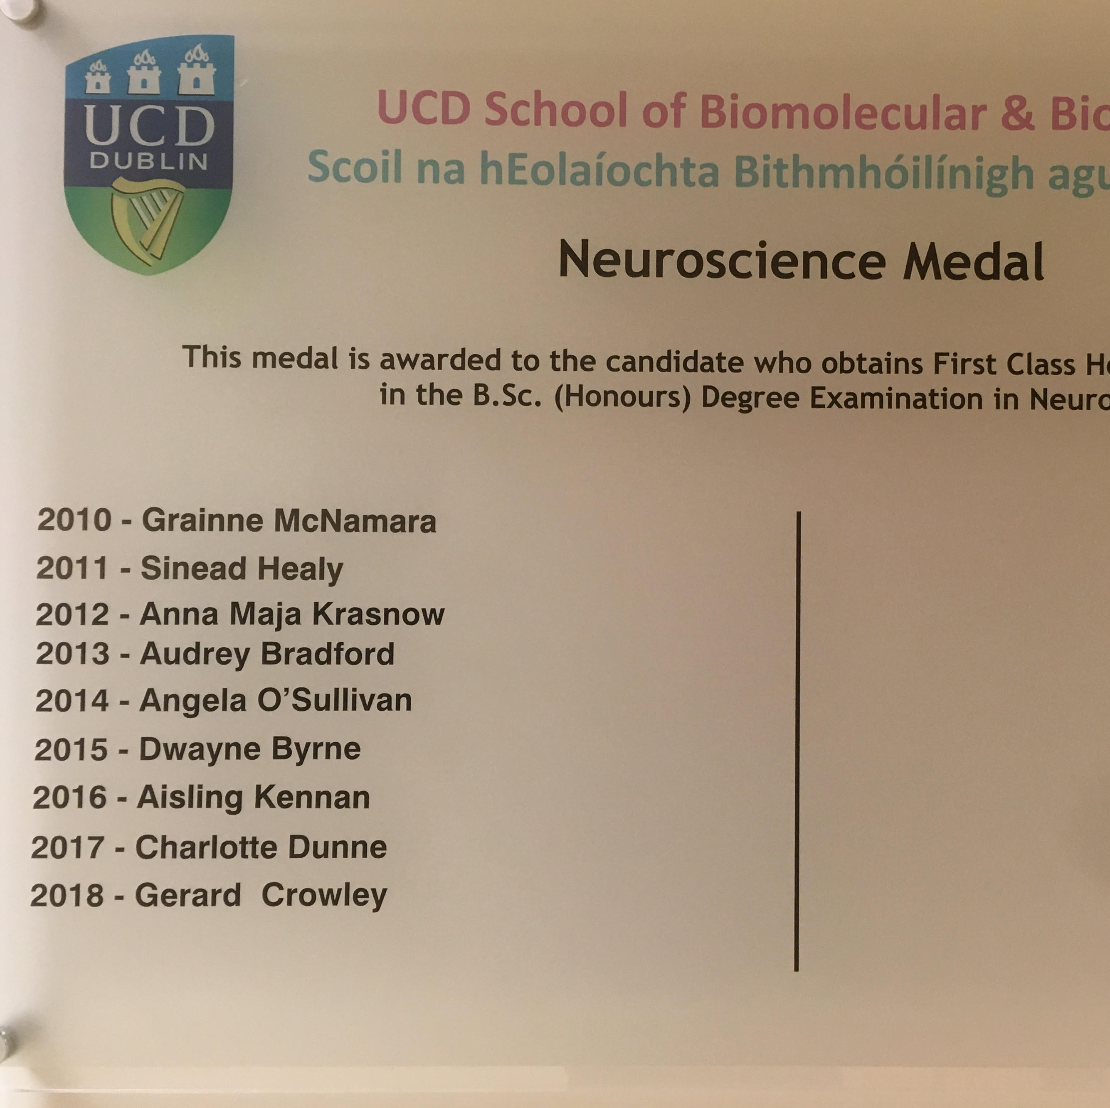
Acknowledgements
Women already dominate in UCD Biomedical Sciences
UCD Undergraduate classes in Biomedical Sciences
UCD Medal winners
(Top Pharmacology or Neuroscience student)
UCD Neurotherapeutics
Research Group
Biochemistry
Current Members
Sarah Abdulmalek
Josiah O’Sullivan
Amie O’Neill
Lisa McDonnell
Michelle Campion
Genetics
Pharmacology
Past Members
Dr. Sean O’Shea
Dr. Azadeh Beizaei
Dr. Danielle Corbett
Dr. Mark Pickering
Dr. Niamh O’Sullivan
Dr. Nanette Rombach
Dr. Jennifer Loscher
Dr. Judith ter Horst
Dr. Paul Halley
Dr. Robert Murphy
Dr. Anita Wdowicz
Dr. Elaine Keogh
Dr. Laura Connole
Dr. Graham Sheridan
Dr. Marco Monopoli
Dr. Siobhan Moyna
Dr. Michelle Nic Raghnaill
Dr. Bart Lukasz
Neuroscience
Microbiology
Physiology
~65% female
~80% female
65% female

Slide 15
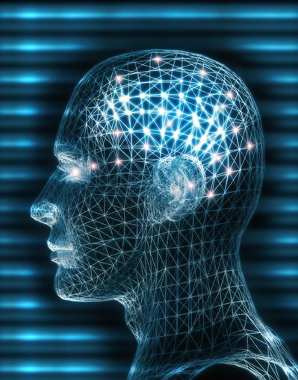
UCD Biomedical Sciences
Self-motivated, hugely rewarding career
Truly exciting time:
New technologies
Truly exciting time:
new understanding and new treatments

Slide 16
Girls Rock STEM
Over to you..

