Slide 1
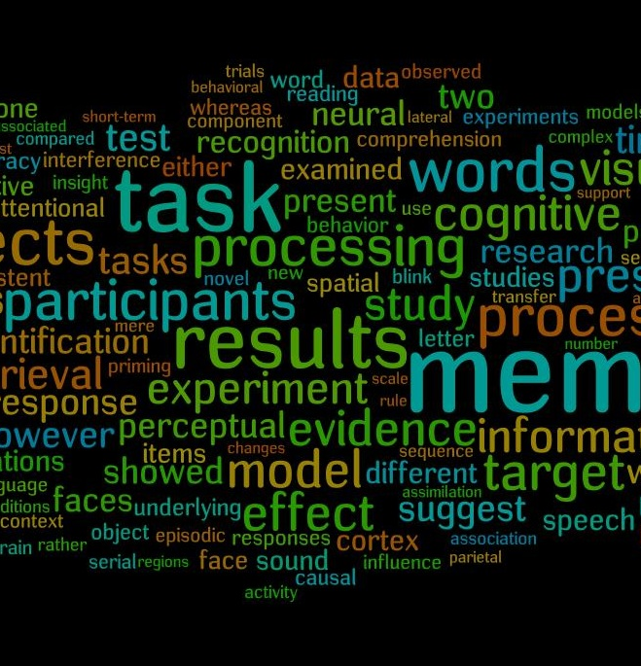
GRAINNE KIRWAN
By Lyla Kane–Walsh, Ashley Coyle and Amelie O'CONNOR
2019

Slide 2
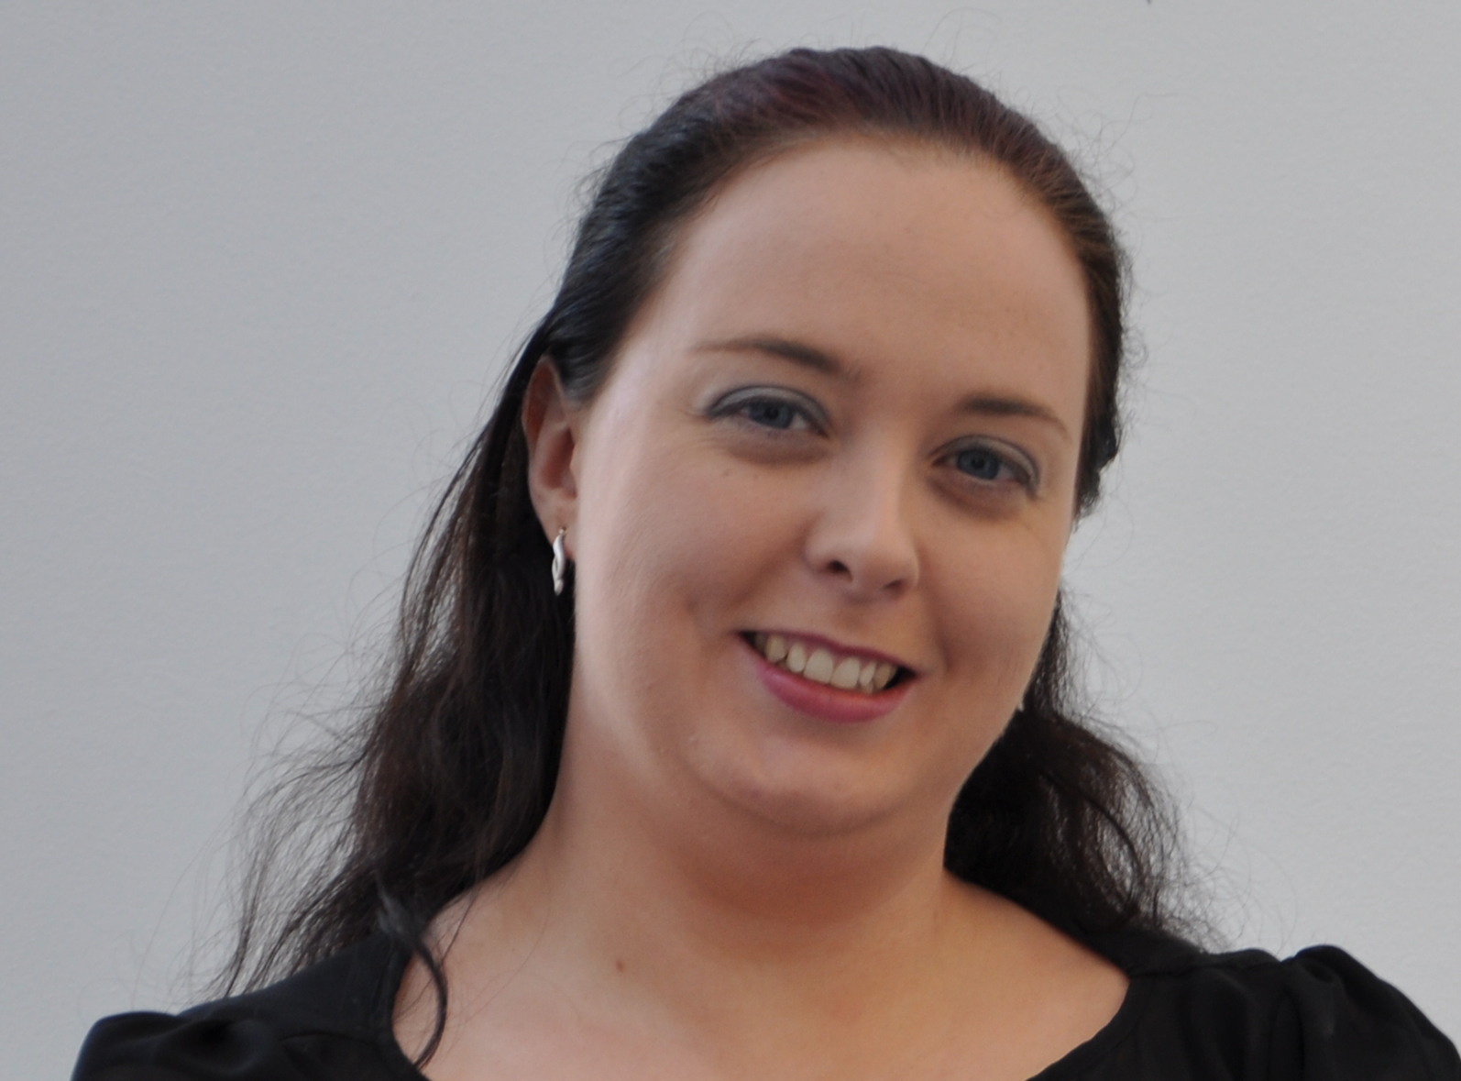
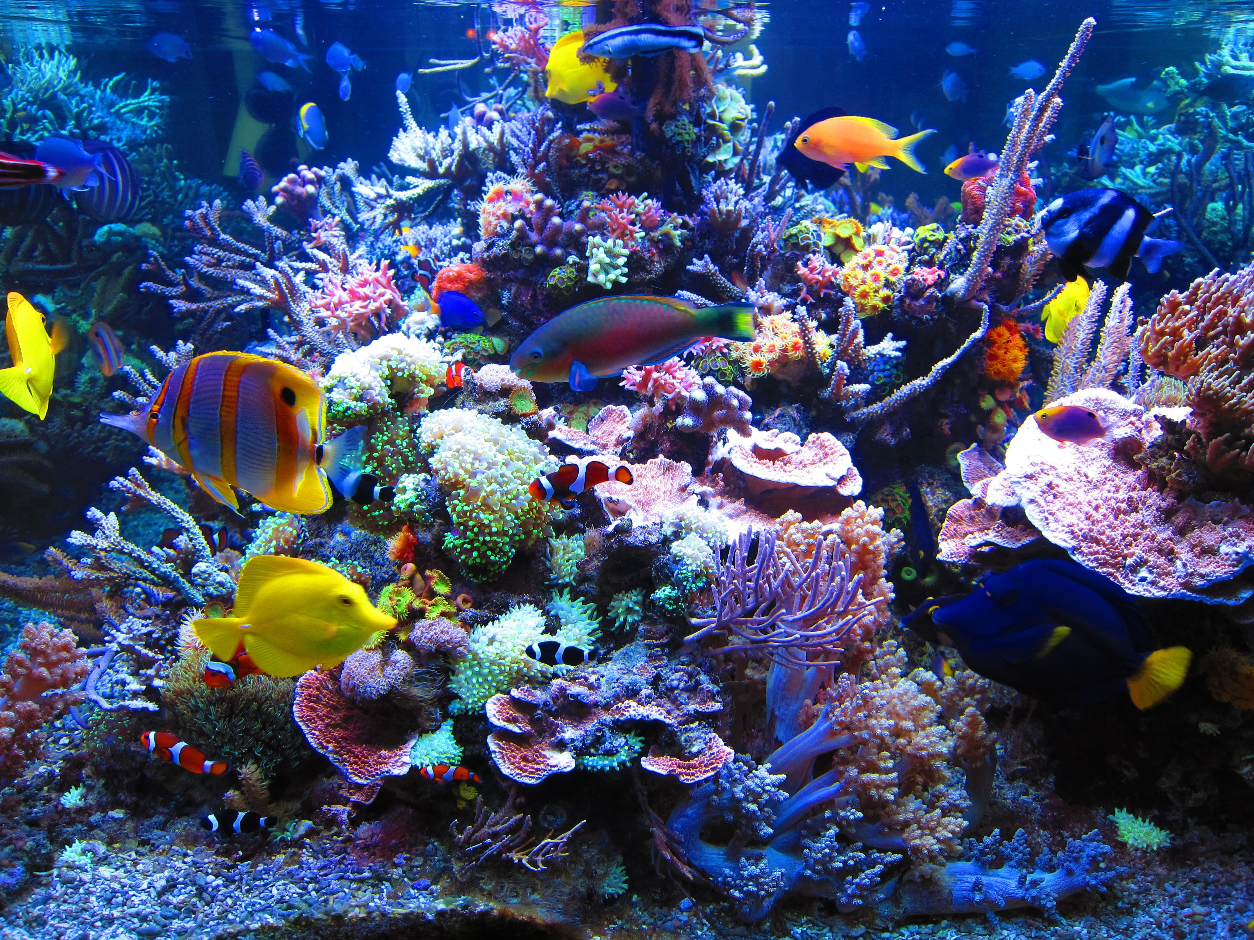
What is a cyber-psychologist?
This Photo by Unknown author is licensed under CC BY-SA-NC.
A cyber-psychologist is someone who studies the human behavior towards the internet and social media.

Slide 3
FUN FACTS THAT YOU DIDN'T KNOW ABOUT GRAINNE!
SHE ATTENDED TULLAMORE COLLEGE.
SHE WAS A MEMBER OF THE ORDER OF MALTA IN TULLAMORE
LYLA'S GRANDAD TRAINED HER IN THE ORDER OF MALTA
SHE WAS ACTUALLY BORN IN ENGLAND BUT MOVED TO IRELAND WHEN SHE WAS A YOUNG CHILD.
SHE CAN SPEAK KLINGON (FROM STAR TREK)
SHE LECTURES IN VARIOUS FIELDS OF PSYCHOLOGY AND HAS CO-WRITTEN BOOKS IN THE SUBJECT
This Photo by Unknown author is licensed under CC BY-NC-ND.

Slide 4
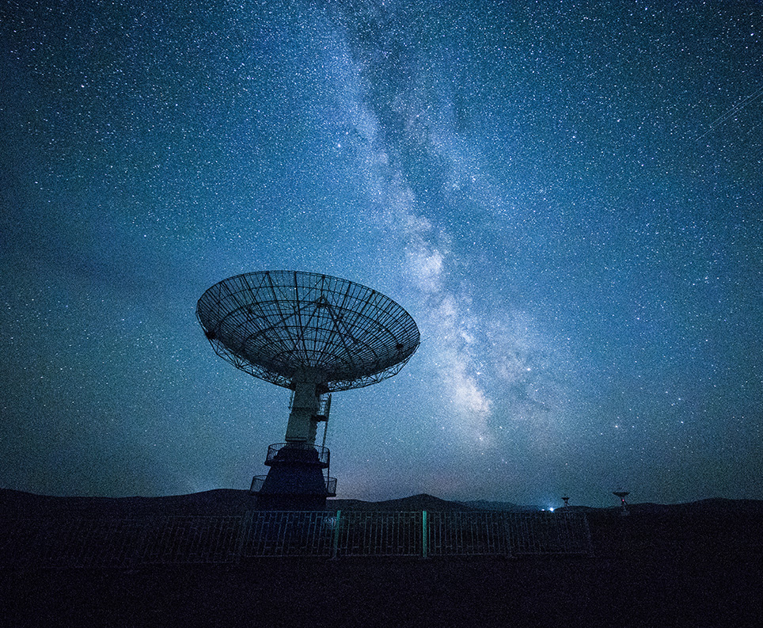
OUR QUESTIONS ABOUT GRAINNE KIRWAN....
WHAT ARE THE CHALLENGES THAT YOU HAVE FACED WORKING IN STEM AS A WOMAN?
WHAT INSPIRED YOU TO WORK IN STEM ?
HAS A MAN EVER TOLD YOU THAT YOU CAN'T WORK IN STEM BECAUSE YOU’RE A WOMAN?
IF YOU COULD GIVE ANY ADVICE ON BECOMING A WOMAN WORKING IN STEM WHAT WOULD IT BE?
DID TULLAMORE COLLEGE INFLUENCE YOU IN WORKING IN STEM?
WHAT INSPIRED YOU TO WRITE BOOKS ON CYBERPSYCHOLOGY?
IS STEM AN EASY JOB TO WORK IN?
DO YOU FEEL THAT IT IS IMPORTANT THAT WOMEN ARE WORKING IN STEM?
HOW DID YOU END UP WORKING IN VARIES OF PSYCHOLOGY?
DID YOU DO ANYTHING RELATED TO YOUR CAREER IN SECONDARY SCHOOL?
WHAT DO YOU HOPE TO ACHIEVE IN THE FUTURE?
WHAT WAS YOUR CHILDHOOD LIKE?
DID YOU SEE SCIENCE AROUND YOU AS A CHILD AND A YOUNG ADULT?

Slide 5
The things we found out WHEN WE INTERVIEWED Grainne:
GRAINNE LECTURES IN UCD UNIVERSITY
GRAINNE HAD A VERY HAPPY CHILDHOOD SHE ALWAYS ASKED FOR SCIENCE EQUIPMENT FOR HER BIRTHDAY and WAS NEVER REALLY A GIRLY-GIRL although SHE STILL LOVED TO PLAY WITH HER DOLLS AS A young child.
GRAINNE LOVES HER JOB BECAUSE she doesn’t have to work every day and can work from home some days which means she has more time to spend with her family.
GRAINNE STUDIED SCIENCE FOR HER JUNIOR CERT AND HER LEAVING CERT.
GRAINNE FEELS THAT IT IS VERY IMPORTANT THAT WOMEN ARE WORKING IN STEM.
WE ASKED GRAINNE "HAS A MAN EVER TOLD YOU THAT YOU CAN'T WORK IN S.T.E.M BECAUSE YOU ARE A WOMAN?”, AND GRAINNE SAID "NO, BECAUSE I THINK WHEN MEN SEE ME THEY SAY OH, BETTER NOT QUESTION HER BECAUSE SHE IS A VERY STRONG AND INTELLIGENT WOMAN”.
GRAINNE HOPES TO ACHIEVE GREAT THINGS IN LIFE AND HAVE A LONG HAPPY LIFE WITH HER FAMILY.
This Photo by Unknown author is licensed under CC BY-NC-ND.

Slide 6
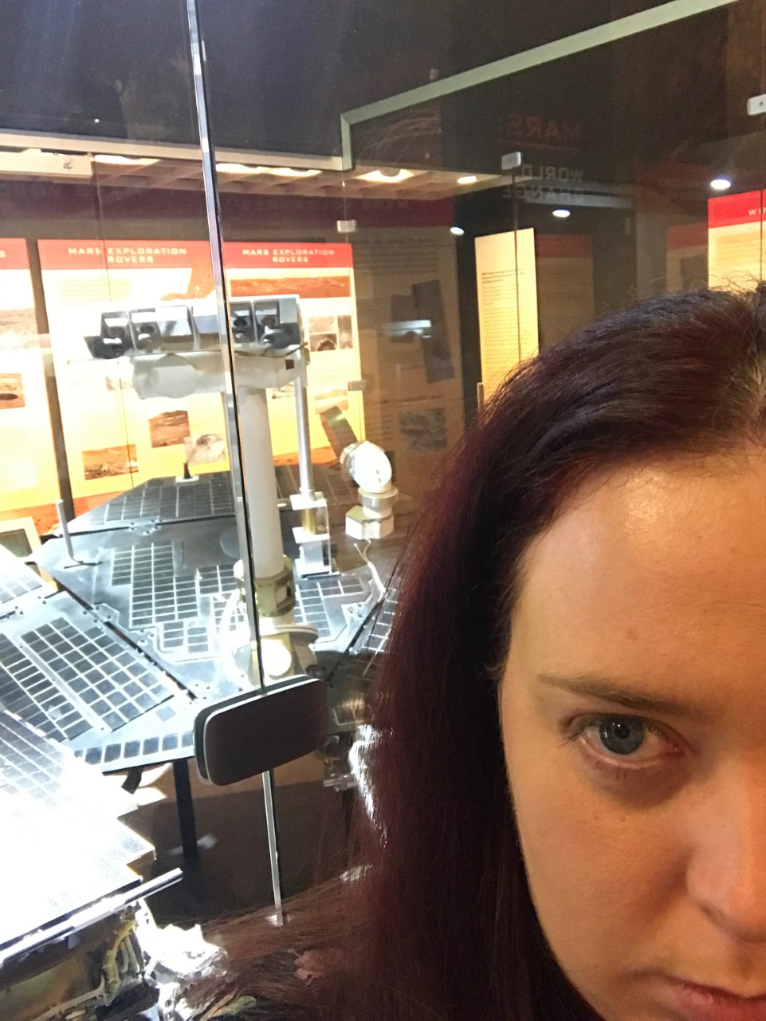
references
Photo of Grainne Kirwan: http://interactivemediainstitute.com/cypsy21/wp-content/uploads/2015/10/grainne-bw.jpg

Slide 7
Thank You for your time!
Grainne, YOU are a big inspiration to us all!
THANK YOU GRAINNE KIRWAN!

